Slide 1
Modern authentication and authorization

Slide 3
Course Overview
Day 1
1.Introduction
Day 2
4. Azure AD Devs
Day 3
6.App development
2.OAuth2 and OIDC
3.ADFS*
5. Azure AD B2C
5.1. I E F**
5.2 Custom UI**
7.ADAL & MSAL
8.OWIN*
9.APIM**
*Obsolete module
** Optional module for reference purposes.

Slide 4
Setup
Class materials: https://aka.ms/mauthbr
Lab environment:
Use own or https://aka.ms/learningCampus:
VS.NET 2019
Fiddler with HTTPS decryption enabled!
Use own or code from https://aka.ms/learningCampus :
Azure subscription (with Global Admin rights to an Azure AD)

Slide 5
Modern authentication and authorization
Why do we need a new way of authenticating users and managing access to resources?

Slide 6
Module Overview
Why…
…do we need a new way of authenticating users and managing access to resources?
What…
…is required to manage identity and access in the cloud environment?
How…
…does MS support these requirements and how do develop with it?
Notes:
Overview
This module includes the following sections:
Lesson 1: Why do we need new infrastructure to manage identity in the cloud?
Lesson 2: What does the infrastructure need to accomplish?
Lesson 3: How does Microsoft’s infrastructure, particularly Azure AD support it?
Lesson 3 is the longest as it deals with several different technologies: Azure AD, Owin, ADAL, WIF.
Speaker Notes
Set expectations that the session is going to be about handling user and process identity and therefore also authorization in the semi- or low-trust environment of the cloud. Cloud here means any publicly accessible Internet endpoints, not just applications in Azure. This is NOT just about Azure AD and NOT ALL of Azure AD is covered. The focus is on developers and therefore developer tools and those aspects of AAD developers typically interface with. For example Multi-Factor Authn, which is part of Azure is not covered here – it is a configuration option, not a developer concern.

Slide 7
Basic Issue
Who are you?
What are you allowed to do?
Client
Resource

Slide 8
Canonical Solution
Domain
Domain
Domain
Client
Service
Tokens
Protocols
Trust
Authority

Slide 9
Cloud Identity vs On-Premises Identity
User:
Employee vs partner/customer/citizen
On BYOD vs company managed devices
Application:
SaaS vs firewalled, company owned (SSO)
Multi-tenant vs single-tenant (who is the authority?)
Directory
Heterogenous networks vs company mandated
Many user populations vs employees
Cloud networks may need to co-exist with on-premises, domain controlled networks
Notes:
This is another way to look at some of the issues introduced by ‘blowing the bubble’ of trusted domains. This slide looks at these issues from the perspective of the three actors.
Again, we are not going to answer these questions here. Rather they serve as an introduction to the next section where we will show the proposed industry solution(s), which attempts to answer/solve these issues. You may consider asking students whether they can see any other issues a semi-/un-trusted environment of the internet needs to address in terms of identity/authentication.
BYOD – Bring Your Own Device
SaaS – Software as a Service
SSO – Single/Seamless SignOn

Slide 10
Modern authentication and authorization
What questions need to answered to support modern authentication?

Slide 11
Objective
How do we manage identity and access in the cloud environment.

Slide 12
Issues
Who does what?
What is the sequence of requests/responses?
Ensure no platform dependency

Slide 13
Who does the critical work?
Application
Application collects credentials and asks the Authority to verify them
(Active)
Tokens
Protocols
Trust
Authority
Authority collects credentials, verifies them and sends confirmation to the Service
(Passive)

Slide 14
Authentication Patterns Compared
 | Active | Passive
+ | Application controls UX for credential collection. | Authority controls UX and how user identity is confirmed (2FA, device, etc.). User is familiar with UX.
- | Requires code to handle high security assets (credentials) | Requires user access to browser-based UI control
 | Needs modification when security requirements (e.g. new MFA) change
 | Needs modification when new authorities are added
 | Susceptible to DoS attacks
 | User sees different UI for each application – could be confusing and opens an attack vector
Use Passive flow unless application is headless or runs on devices with no browser-based control
Notes:
UX – User Experience (UI)
2FA – 2nd Factor (as in multi-factor authentication), e.g. secret, one-use code sent to mobile phone.
UI – user interface
DoS – Denial of Service

Slide 15
Passive Flow (Service Provider, SP-Initiated)
1
Token
Authority
4
0
Validate!
Trust
A
A
3
A
Application
2
5
Cookie
Notes:
SP – Service Provider (Application) as opposed to IdP – Identity Provider/Authority
STS – Security Token Server
This is an example of a passive client authentication flow, implemented by WS-Fed and SAML-P (there are some differences between these two that are not relevant here, e.g. format of the request/response messages):
0. Before first use, application is given the public key component of a certificate the STS will use to sign its tokens. (With ADD the public key is obtained by the application at application start using the WS-Federation metadata endpoint. The certificate changes +-1/month).
User navigates to an application
Application detects (no authn cookie) that the user is un-authenticated and returns a redirect (http 302) to the STS
The STS challenges the user for credentials, or if the user has already authenticated with this STS, retrieves user identity from a cookie (silent authentication)
The STS validates the user, constructs a token with claims it agreed to supply to the application, signs the token and issues a redirect (http 302) back to the application
Remember to mention what’s IdP-initiated flow.

Slide 16
Passive Authentication – Notable Facts
No need for direct connectivity between the STS and the Application.
Single sign-on
Security and control of credentialing in one place
Composability – federation with other authorities
Notes:
There is no need for direct connectivity between the STS and the Application.
User needs to authenticate to the STS once only. After that, the STS can use a cookie to keep track of who the user is (SSO support).
The application has no access and does not deal with user credentials. It is not even aware of how the STS determined users identity (password, certificate, Multi-Factor Authentication; this info may be communicated back to the application as a claim).
Composability – you can chain multiple STS’es using the same (or different) passive protocol
Side benefit: un-authenticated Denial of Service attacks handled by external STS, not the application

Slide 17
Federation
Ability to compose token issuance process using multiple issuers
Examples: sign in to a site using one of several social identities, multi-tenant apps (O365)
Identity
Provider (IdP)
Trust
Identity
Provider (IdP)
Authority
Federation
Provider (FP)
Trust
Application
Trust

Slide 18
Home Realm Discovery (HRD)
How does an FP know which IdP to re-direct the user to?
Common solutions
List all possible IdP and let the user choose
Discover from user’s entry, e.g. domain of the user’s email address
Include reference to IdP in the initial site url

Slide 19
Passive flow initiation
Service Provider Initiated (SP Initiated)
Application redirects to STS with protocol specific request message
Supported by both WS-Federation and SAML Passive
Identity Provider Initiated (IdP Initiated)
User navigates to STS with a token request message
Message includes parameter with application to redirect to, or…
STS determines which application to redirect the response with token
Supported only by SAML protocol
Notes:
WS – Web Services, prefix used for a series of standards for SOAP message headers
SAML – Security Application Markup Language

Slide 20
Glossary
Security Token – about a user, serialized and signed, e.g.: JWT (Json) and SAML (Xml).
Security Token Server – a web service capable of determining user identity (e.g. via password credentials) and issuing a Security Token using an authentication/authorization protocol.
Claims – a collection of name/value pairs items describing a user (e.g. email address, display name, age).
Authentication/Authorization protocol:
Token format
Message sequence and format
Notes:
This and the following two slides may be skipped if the attendees are familiar with general authentication concepts.
JSON – JavaScript Object Notation
JWT – JSON Web Token

Slide 21
Examples
Concept | Technology
Authority | Azure AD AD Federation Server (ADFS) Ping
Token format | JWT (Json Web Token) SAML (Security Assertion Markup Lang)
Protocol specification | WS-* SAML-P OAuth2 OpenIDConnect (OIDC)

Slide 22
JWT Security Token example
Raw
eyJhbGciOiJSUzI1NiIsIng1dCI6IjdkRC1nZWNOZ1gxWmY3R0xrT3ZwT0IyZGN….
Decoded
{ alg: "RS256",
x5t: "7dD-gecNgX1Zf7GLkOvpOB2dcVA",
typ: "JWT"
}.
{ aud: "https://contoso.com",
iss: "https://sts.windows.net/",
nbf: 1391210850,
exp: 1391214450,
sub: "21749daae2a91137c259191622fa1“,
mail: “abc@xyz.com”
}.
[signature]
Notes:
Also: see www.calebb.net

Slide 23
Authentication requests examples
SAML-P
<samlp:AuthnRequest xmlns="urn:oasis:names:tc:SAML:2.0:metadata" ID="id6c1…2730" Version="2.0“
IssueInstant="2013-03-18T03:28:54.1839884Z" xmlns:samlp="urn:oasis:names:tc:SAML:2.0:protocol"> <Issuer xmlns="urn:oasis:names:tc:SAML:2.0:assertion">https://www.contoso.com</Issuer> </samlp:AuthnRequest>
Additional steps: compress, base64 encode, url encode
WS-Federation
https://login.windows.net/common?wa=wsignin1.0&wreply=https://res.resource.com/sales&wct=2013-03-03T19:06:21Z&wctx=0A2DG...
OpenID Connect
https://login.windows.net/common/oauth2/authorize?response_type=id_token&client_id=4ae4...cc8bd&
scope=openid&nonce=7362CA…EBA7&response_mode=form_post
May also include ‘code’ and/or ‘token’ as response type; login_hint

Slide 24
Single Sign-In is Easy – Single Sign-Out is Not
Is the user signing out from this app only or all apps?
Which apps has the user signed in?
Which protocols does each app use?
OIDC defines draft only – none implemented
Using multiple STS’ in same browser
Notes:
OIDC – OpenIDConnect

Slide 25
Handling Single Sign-Out
You have been signed out from THIS APPLICATION ONLY. Please close all browser windows to be signed out from other applications as well.

Slide 26
Limits of Passive Authentication
Browser not (always) available for passive (redirected) flow
Device has no browser (e.g. IOT)
Client is a SPA – redirection would destroy app state
Up-stream APIs
Notes:
SPA – Single Page App
Passive authentication, while very common has its limits. Mobile apps in particular, where the code runs on the client platform requires more advanced capabilities (e.g. ability to silently refresh authentication) without having a browser surface to have the server and STS talk to each other via a redirection. Same applies to a server side application needing to authenticate itself to another server. Javascript Single Page Applications (SPA), while running in the browser do not allow the server to suddenly displace them (and their state) with a redirection to the STS or back to the server.
For this reason another way of authentication users and authorizing their applications to access other resources has been proposed: Oauth, now at version 2. It is owned by the IETF.

Slide 27
Modern authentication and authorization
How does MS support these requirements and how to develop with it? ​

Slide 28
Describe how Microsoft supports requirements to manage identities and access in the cloud and how to develop with it.

Slide 29
Microsoft Identity Environment
Cloud
AAD
(STS)
PAAS
EasyAuth
VNet
GraphAPI
Protocol
endpoints
VMs
App
AAD DS
Applications
PTA
WIF
AADConnect
(optional)
AAD AP
Federation
(optional)
Owin
WAP
On-premises
MSAL/ADAL
AD
AD FS
(STS)
LDAP
Protocol
endpoints
Notes:
This slides uses animation to build the picture of major cloud identity components:
Starts with on-premises AD
Which uses ADFS (Active Directory Federation Service) to expose the AD as an STS (AD by itself is not an STS in internet terms).
To expose the STS to the public internet we may use Web Application Proxy (WAP), a reverse server proxy for crossing the firewall.
Azure AD is like AD/ADFS. It is a multi-tenant cloud service, exposing most of the same protocol endpoints. It uses REST GraphAPI where on-premises AD would use LDAP.
Applications use various .NET classes or separate SDKs to interact with the authentication protocols. The three noted here represent commonly used names for these collections of classes, these are not necessarily product names:
WIF – Windows Identity Foundation was a separate .NET SDK, which since 4.0 is part of .NET as System.IdetityModel namespace. It is used for Security Token processing.
Owin – is a namespace in .NET with classes used by ASP.NET applications to configure authentication protocols used by the application
ADAL – is a collection of toolkits for different platforms (.NET, iPhone, Android, JS) used to manage client side of OAuth2 protocol.
AAD DS adds Kerberos domain control management features to AAD

Slide 30
Choosing the authentication method
Cloud Authentication
Cloud accounts only
Password hash synchronization
Pass-through authentication
Requires least effort to implement
Federated Authentication
Allows full use of on-premises authentication infrastructure (e.g. smartcards)
SSO to all apps for on-premises users
See: https://docs.microsoft.com/en-us/azure/security/azure-ad-choose-authn
Notes:
https://docs.microsoft.com/en-us/azure/security/azure-ad-choose-authn

Slide 31
Azure AD Modes
B2E – Business to Employee
Membership controlled by one organization
Usually one (few) domains
Often sync’ed with on-premises store (e.g. Active Directory)
B2B – Business to Business
Possibly existing B2E
Supports membership from other orgs
Uses federation with the other tenants
Enables access to resources managed by this tenant
B2C – Business to Consumer
Separate tenant from B2E
Customizable attribute structure
Customizable registration, login, logout, pwd reset UI
Support for resident and social ids (FB, gmail, MSA)

Slide 32
Knowledge check
What are the benefits of passive authentication?
How does an application know a token came from a trusted issuer?
How does an STS decide whether to respond to a request for security token from an application?
True or false: an application defined in Azure AD must be deployed to Azure Cloud?
What protocols does Azure AD support?
True or false: Azure AD requires an on-premises installation of ADFS?
Notes:
A) app does not need to handle credentials and related functionality b) credential validation may be amended without impact on app c) DOS handling is outsourced d) SSO e) federation
By validating that the token signature is valid and that it was signed by a key, whose public part the application knows.
STS checks whether the application submitted an id known to it and whether the reply url matches what the STS has
False
WS-federation, SAML-P, OAuth2 and Graph API
False
Client-side Oauth protocol handling. Different versions for different client platfoms (.NET, iOS, Android, etc.)
REST-based programmatic access to Azure AD tenant data

Slide 33
A new approach is needed when client, server and/or authority are not in a single domain​
Protocols and token formats​
Microsoft infrastructure and tools​

Slide 35
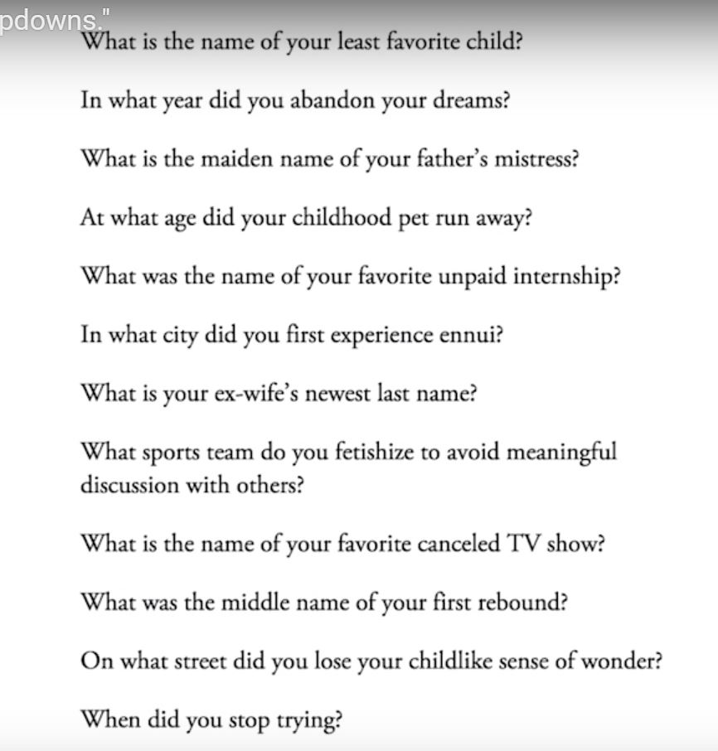
Security questions
Notes:
From fuckdropdowns

